Slide 1

INTERNSHIP REPORT For WEEK 8
MITRE ENGAGE
& HONEYPOTS
-ARUN ASHOK BADRI

Slide 2
INTERNSHIP GOALS :
(1) read the MITRE Engage documents; each one of you needs to select one of the goals (Expose, Affect, and Elicit) to study deeper and define each action under these goals in detail.
(2) Propose possible actions to be implemented in SSH honeypot and AD honeypot. There are about 10 to 20 actions listed under each goal. Try to propose corresponding actions for these two honeypots.
(3) Real implementation: Each of you needs to implement at least four actions according to your design in (2) in the real honeypots.

Slide 3
MITRE ENGAGE AND IMPLEMENTATION OF AFFECT GOAL USING HONEYPOTS
INTERNSHIP REPORT PLAN
Month 1: Orientation and Goal Selection
Month 2: Proposal and Planning for Honeypot
Month 3: Implementation and Documentation

Slide 4
Goals for this week
As mentioned in my last week report
> Create a new fs.pickle for the cowrie
> Create a new honeyfs file system in cowrie
> Integrate both and deploy Cowrie
> Real implementation of ‘Lures’ of Affect goal
> Search for other possible implementations for any Affect goal approaches

Slide 5
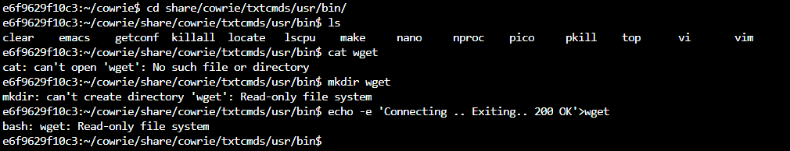
> ERROR !!
As of last week reporting
Error due to the Docker container being in a read only state

Slide 6
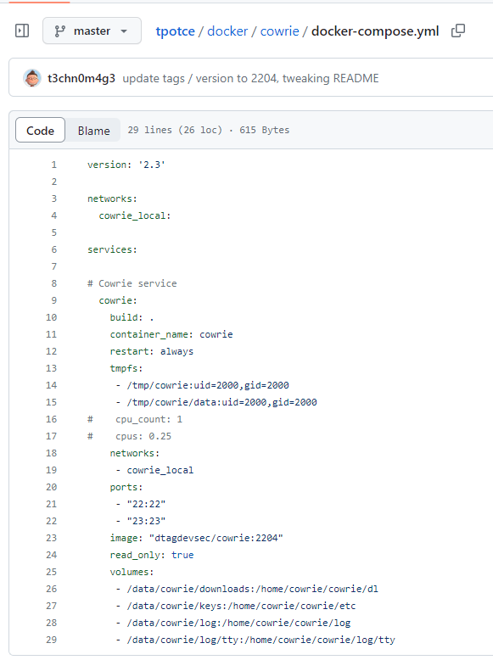
> Why ??
Error due to the Docker container being in a read only state

Slide 7
> How to solve ??
Thanks to Howard ; )
Before installing the Honeypot, We need to configure the docker-compose.yml file
Once configured, create an iso file using ./makeiso and use the iso file to create a vm and install the Honeypot
Once installed remove the old container and reconfigure the new container
Finally set-up the fs in the pickle file and honeyfs directory

Slide 8

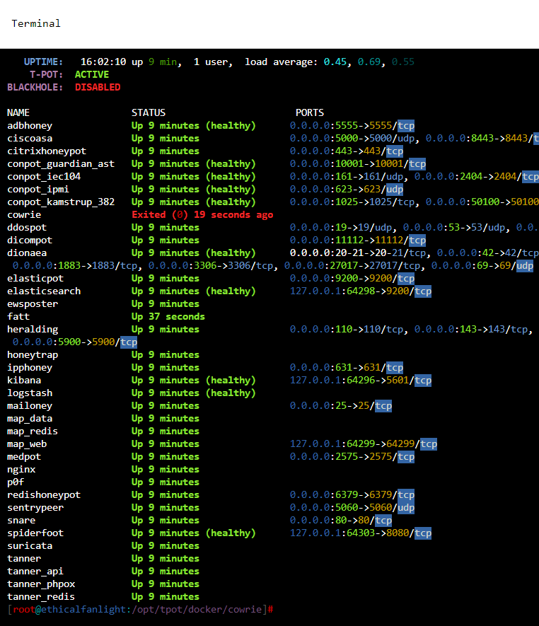
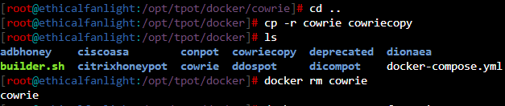
> How to Solve ??
Once container is stopped, remove the old container

Slide 9
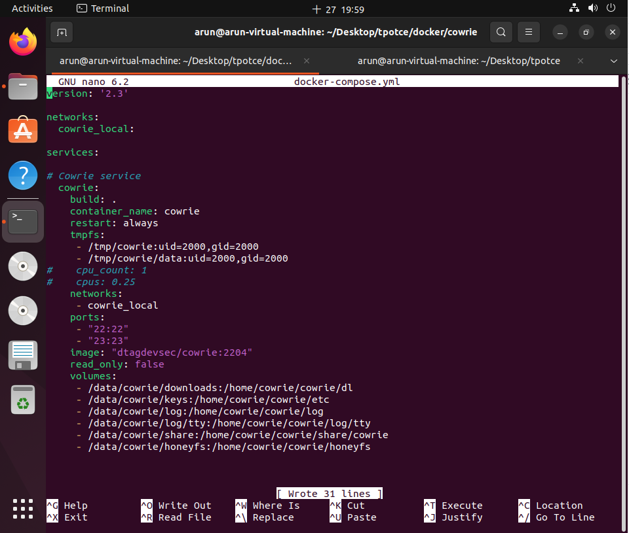
> How to solve ??
Open docker-compose.yml and edit
Set Read-only to False
Two new volumes added to handle fs.pickle and honeyfs directory

Slide 10
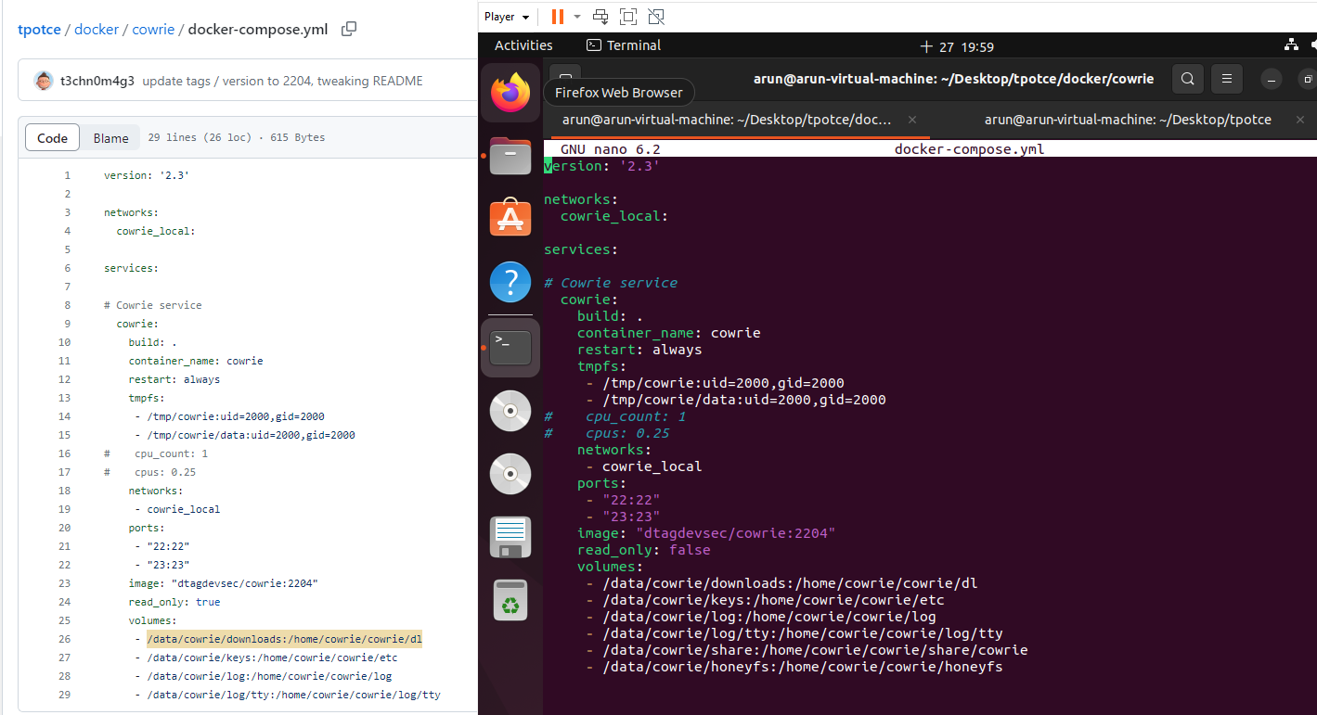
> How to solve ??
comparison between edit and original

Slide 11
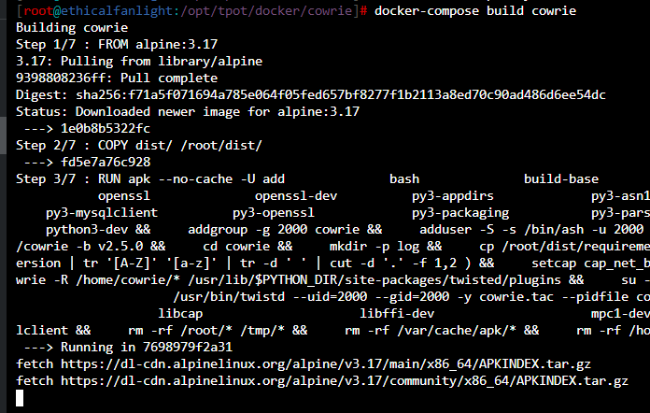
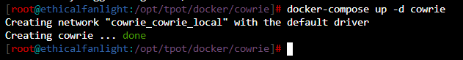
> What next ??

Slide 12
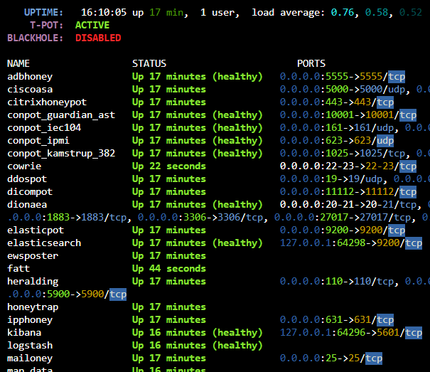

> What next ??
Verify the Container status
using dps.sh

Slide 13
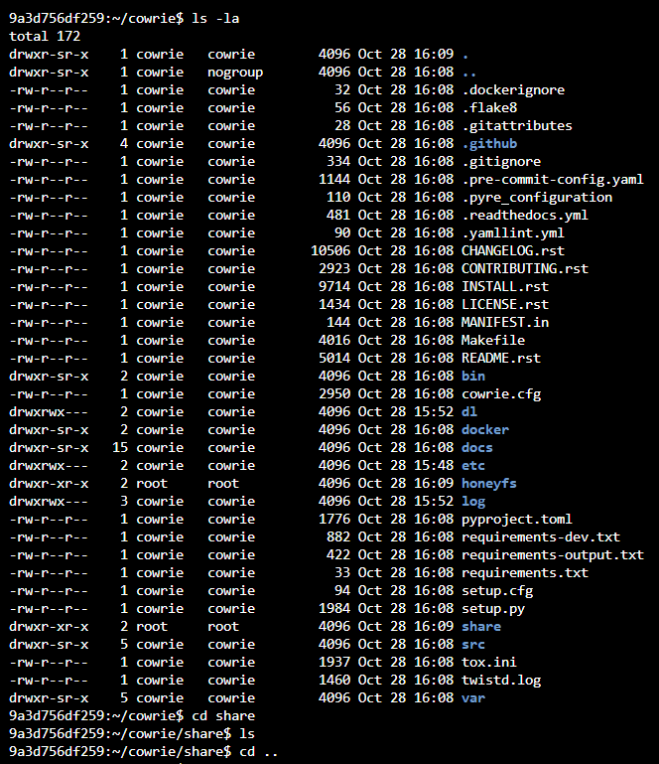

> What next ??
Go into the container fs using the command,
docker exec -it cowrie /bin/bash
Verify that the honeyfs & share directory need root permission to modify ==> Host account

Slide 14
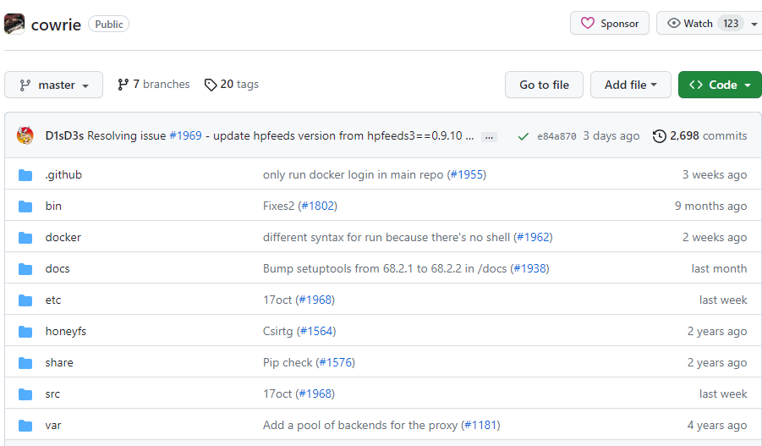
> What next ??
Lets focus on these two folders for further setup

Slide 15
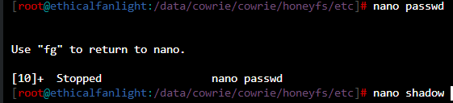
> Lets set up some Lures !!
Lets focus on the honeyfs/etc/passwd & shadow file from host system

Slide 16
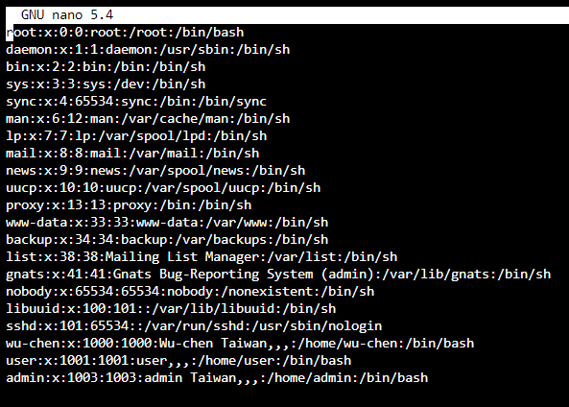
> Lets set up some Lures !!
3 new Users added to make it look more authentic

Slide 17
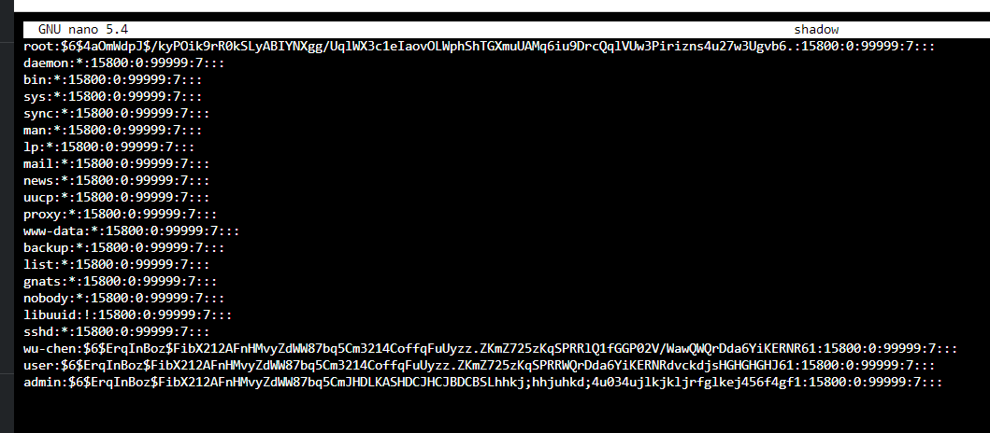
> Lets set up some Lures !!
Same with the shadow file in the directory

Slide 18
> Lets set up some Lures !!
To ensure that this file system is visible in the cowrie honeypot, when attackers logs in, we need to Implement the same users in fs.pickle also
To configure and edit the fs.pickle we need to run the command below,
cd bin
./fsctl /home/cowrie/cowrie/share/cowrie/fs.pickle

Slide 19
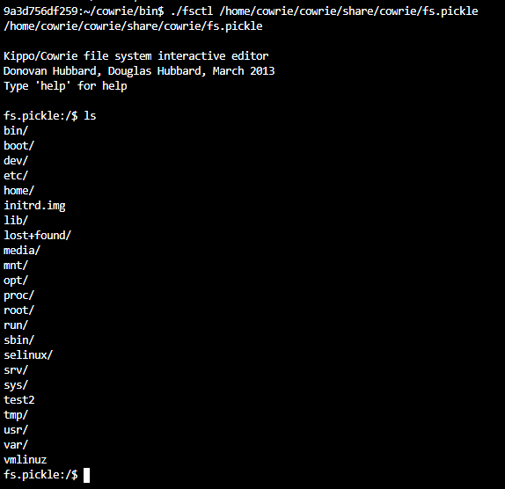
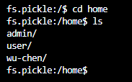
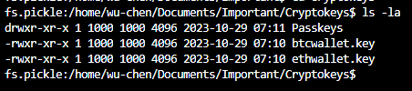
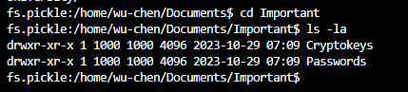
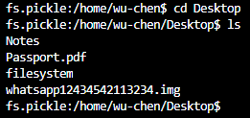
> Lets set up some Lures !!

Slide 20
> Lets set up some Lures !!
Now that we have set up the fs.pickle file in the cowrie file system to mimic few different users, whenever attacker connects to the cowrie, he CAN ‘see’ all of the contents, BUT he CANT ‘read’ or ‘execute’ them.
To allow the attacker to read and execute the files in the fs.pickle ( To Lure him inside the file system), we need to add the files in the /honeyfs directory.
Lets add the lures in the /honeyfs directory now..

Slide 21
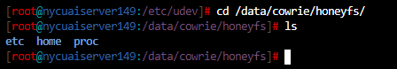
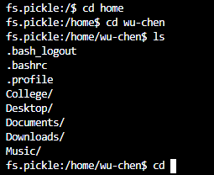
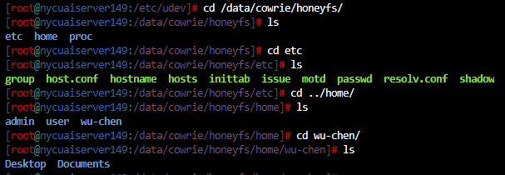
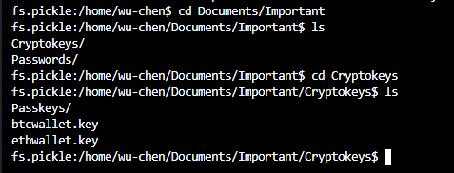
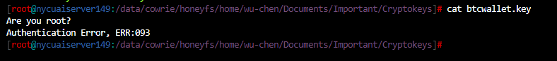

> Lets set up some Lures !!
Honeyfs
fs.pickle

Slide 22
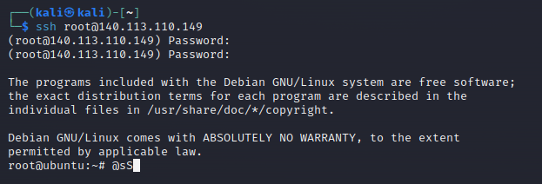
> From ATTACKERS perspective ;
Attacker does an Nmap scan on the honeypot IP
ssh root@140.113.110.149

Slide 23
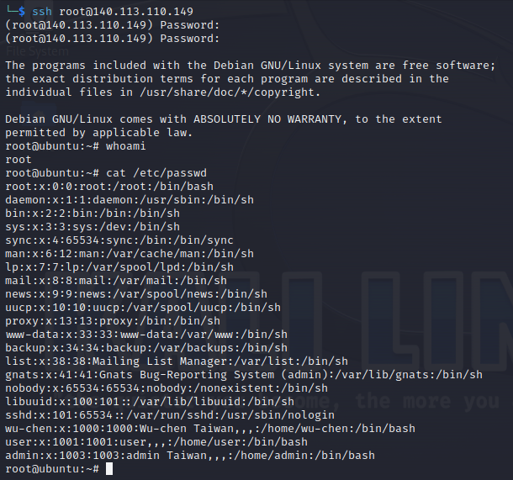
> From ATTACKERS perspective ;
Passwd file of the cowrie fs showing all 3 users that i created in the fs.pickle

Slide 24
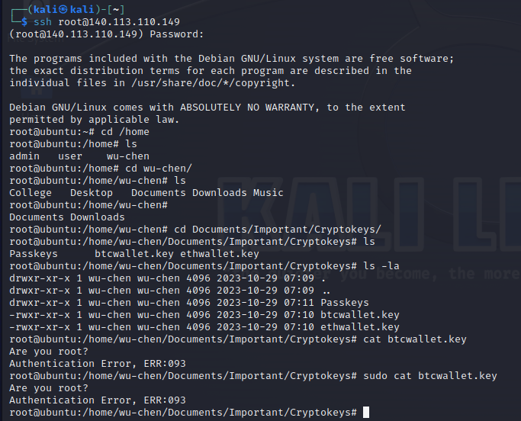
> From ATTACKERS perspective ;
Pre-configured command response set up in the /share/cowrie/txtcmds folder

Slide 25
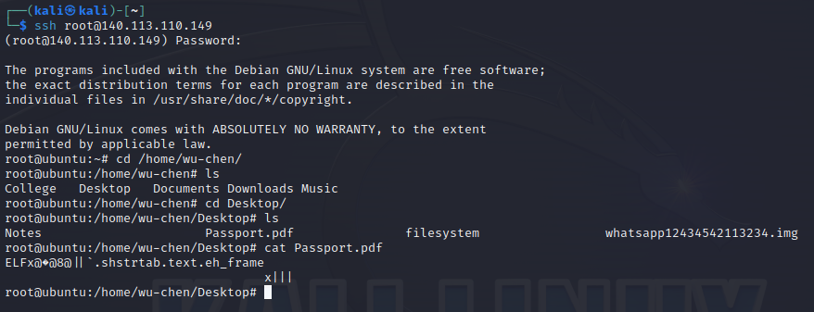
> From ATTACKERS perspective ;
Passport.pdf is present in the /fs.pickle (fake) but not in the /honeyfs (real file system) ==> the file cant be opened and it gives an error.

Slide 26
> From ATTACKERS perspective ;
Using similar Lures we can ensure that we waste as much time as possible when attackers try to attacks the server
We can implement malicious files to gain reverse shell access to the attackers computer by using Lures like Cryptokeys.txt or Passwords.key etc
With this, the successful implementation of Lures in the cowrie honeypot is completed.

Slide 27
Thank
you!

